Slide 1


Smart Mobility Engineering Lab (ISE3231)
Week _ Lecture
ISE Department Prof. Mehdi Pirahandeh
School of Global Convergence Studies

Slide 2

SLAM
1
School of Global Convergence Studies

Slide 3
Goals
____
____
____
School of Global Convergence Studies

Slide 4
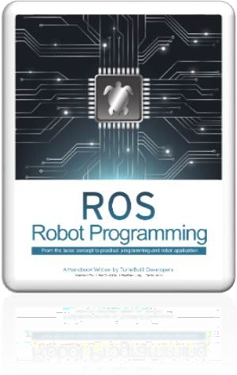
Contents
Run SLAM Node and Teleoperation Node
Tuning Guide
Save Map
School of Global Convergence Studies

Slide 5
I. Run SLAM Node and
Teleoperation Node

Slide 6
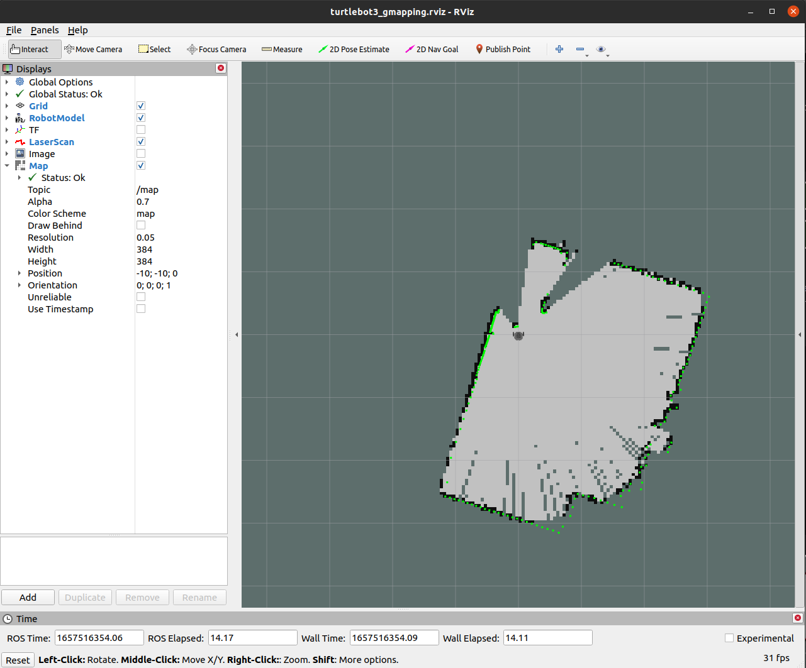
Run SLAM Node and Teleoperation Node
Run roscore from Remote PC
ubuntu@ubuntu:~$ roscore
Open a new terminal and Connect to Raspberry Pi with its IP address. The default password is `turtlebot`
ubuntu@ubuntu:~$ ssh ubuntu@RASPBERRY_PI_IP_ADDRESS
ubuntu@ubuntu:~$ export TURTLEBOT3_MODEL=burger
ubuntu@ubuntu:~$ roslaunch turtlebot3_bringup turtlebot3_robot.launch
Open a new terminal and launch the SLAM node. The Gmapping is used as a default SLAM method.
ubuntu@ubuntu:~$ export TURTLEBOT3_MODEL=burger
ubuntu@ubuntu:~$ roslaunch turtlebot3_slam turtlebot3_slam.launch
*** To save TURTLEBOT3_MODEL parameter
ubuntu@ubuntu:~$ echo “export TURTLEBOT3_MODEL=burger” >> ~/.bashrc
School of Global Convergence Studies

Slide 7
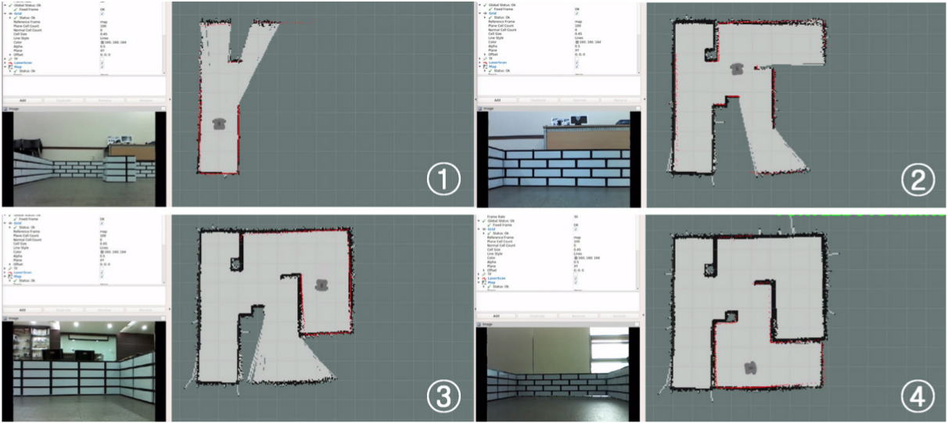
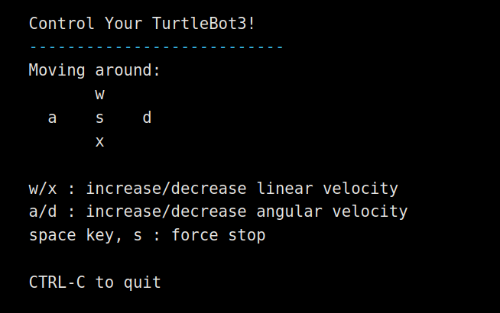
Run SLAM Node and Teleoperation Node
Open a new terminal and tun Teleoperation node from Remote PC
ubuntu@ubuntu:~$ export TURTLEBOT3_MODEL=burger
ubuntu@ubuntu:~$ roslaunch turtlebot3_teleop turtlebot3_teleop_key.launch
School of Global Convergence Studies

Slide 8
II. Tuning Guide

Slide 9
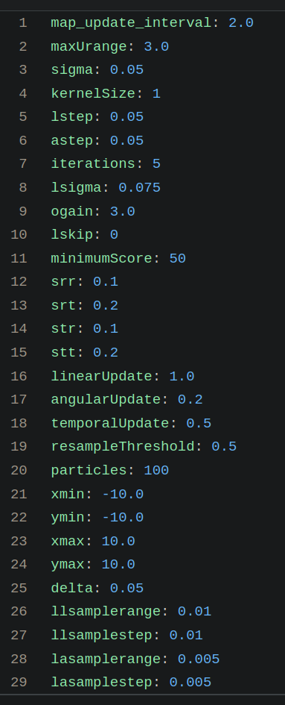
Tuning Guide
Gmapping has many parameter to change performance for different environments
We can get an information about whole parameters in ROS Wiki or refer to Chapter 11 of ROS Robot Programming Book
This tuning guide provides when configuring Gmapping parameters.
Gmapping parameters are defined in turtlebot3_slam/config/gmapping_params.yaml file
School of Global Convergence Studies

Slide 10
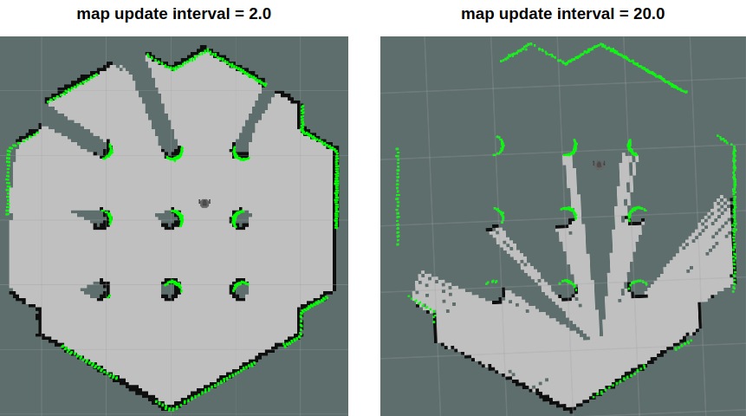
Tuning Guide
maxUrange – is set the maximum usable range of the lidar sensor
map_update_interval – defines time between updating the map
minimumScore – sets the minimum score value that determines the success or failure of the sensor’s scan data matching test.
* this can reduce errors in the expected position of the robot in a large area
lineraUpdate – when robot translates longer distance than this value, it will run the scan process
angularUpdate – when the robot rotates more than this value, it will run the scan process.
* it is recommended to set this value less than linearUpdate
School of Global Convergence Studies

Slide 11
III. Save Map

Slide 12
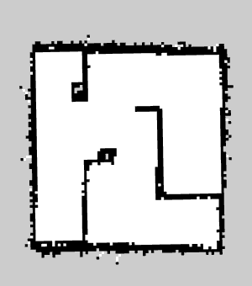
OpenCR Setup
The map is drawn based on the robot’s odometry, tf and scan information.
These map data is drawn in the Rviz window as the TurtleBot3 was travelling.
After creating a complete map of desired area, save the map data to the local drive for the later use
Save map
Launch the map_saver node in the map_server package to create map files
ubuntu@ubuntu:~$ rosrun map_server map_saver -f ~/map
The map file is saved in the directory where the map_saver node is launched at
Unless a specific file name is provided, map will be used as a default file name and create map.pgm and map.yaml (with the above command, map files will be save in the home folder)
The -f option specifies a folder location and a file name where files to be saved.
Map
The map uses 2D Occupy Grid Map (OGM), which is commonly used in ROS.
The saved map will look like the figure below, where white area is collision free area while black area is occupied and inaccessible area, and gray area represents the unknown area.

